Slide 1



KEEPING THE BUILD UP-TO-PAR An empirical study on in-range breaking updates in the npm ecosystem
Presented By Benjamin Rombaut MSc Student
Software Analysis & Intelligence Lab
Queen’s University
Kingston, Ontario, Canada
Notes:
Hi everyone. I’ll be presenting my project called “Keeping the build up-to-par. An empirical study on in-range breaking updates in the npm ecosystem”

Slide 2
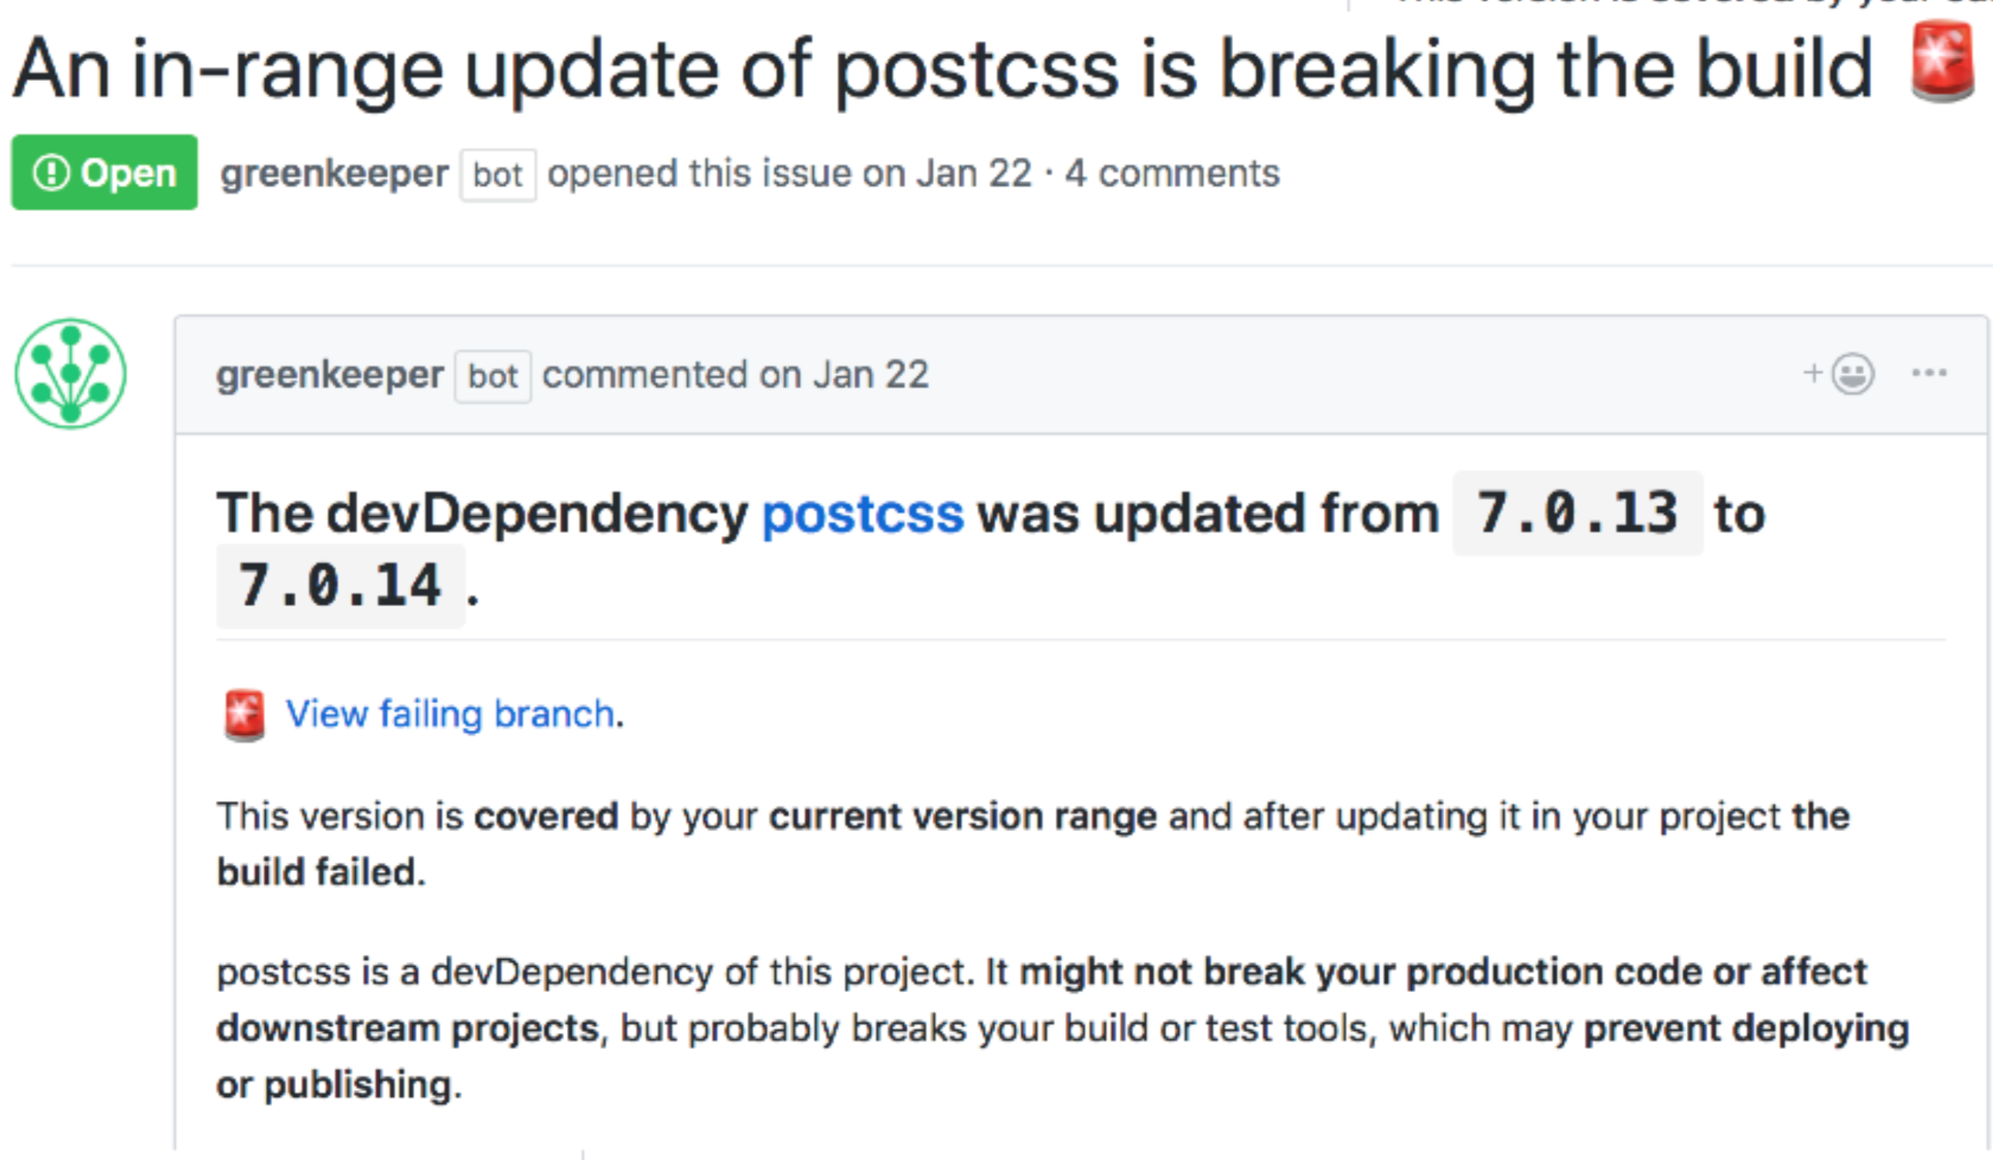
Breaking in-range updates
Clients can specify accepted versions of dependencies they would like to use.
Greenkeeper automatically tests new dependency versions, and opens issue reports if they fail a project’s CI pipeline.
Breaking build issue reports for in-range updates means the project will fail to build for any new installs or upgrades.
Notes:
So just a quick recap on my project. Dependency relationships allow a client package to reuse a certain version of a provider package. These provider packages often release versions containing bug fixes, new functionalities, and security enhancements, so it is important for the clients to keep their dependencies up to date. However, these updates sometimes include breaking changes, and the provider does not always explicitly follow the semantic versioning scheme that allows clients to specify updates they would like to receive.
Greenkeeper is a tool that practitioners can integrate with their project. It sits between npm and GitHub, watching the modules their repo depends on. Each time one of these dependencies is updated, Greenkeeper opens a new branch with that update. The repository’s CI tests run, and Greenkeeper watches them to see whether they pass or fail. Based on the test results and the client’s dependency version definitions, Greenkeeper will open up an issue report in the client’s repository with information stating which dependency update caused the problem.
One of the key points to understand here is the “in-range update” on these issue reports. Semantic versioning works so that, as a client, you can specify a range of versions you would like to be able to use from a provider. This is done so that you can automatically receive simple bug fixes and patch updates as the provider releases them. This point is important because, if Greenkeeper is opening an issue for an in-range update that is breaking your build, it means that if someone were to download and install your package right now, or just try to update the dependencies on your project, it would fail to build. So there should be a certain level of urgency from developers when they get these issue reports.

Slide 3



Characteristics of in-range breaking updates and how client’s resolve their build
What are the characteristics of in-range updates that break a client’s build?
01
How do clients respond to in-range breaking updates?
02
Do broken builds in clients prompt a response from the breakage-inducing provider?
03
Notes:
Our project proposes to examine these in-range breaking build issues to determine characteristics that cause these build failures, as well as how client’s respond to these issues and how they resolve their build. Specifically, we look at the following research questions:
What are the characteristics of in-range updates that break a client’s build?
How do clients respond to in-range breaking updates?
Do broken builds in clients prompt a response from the breakage-inducing provider?

Slide 4

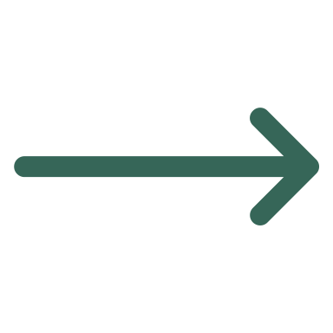


Data Collection
Greenkeeper
GitHub API
Libraries.io
12,134 Projects
123,197 Issue Reports
365,625 Comments
209,750 Events
17,623 Commits
556,742 Version Release Records
Release Frequency of 7,361 Projects
Notes:
The data set for this project is based on over 12 thousand projects we found that have integrated with Greenkeeper. We collected information on each repository, including each projects dev and production dependencies. We then collected over 123 thousand breaking build issue reports that were created by Greenkeeper, and for each of these issues, we collect all of it’s associated comments and events. If there were any commits that referenced the issue report, we retrieved the information for it as well.
Once we had extracted the dev and production dependencies of each of these projects, we pulled all of their release version history from libraries.io, for a total of over 550 thousand version release records, and we were able to calculate the release frequency of over 7 thousand unique dependencies.

Slide 5
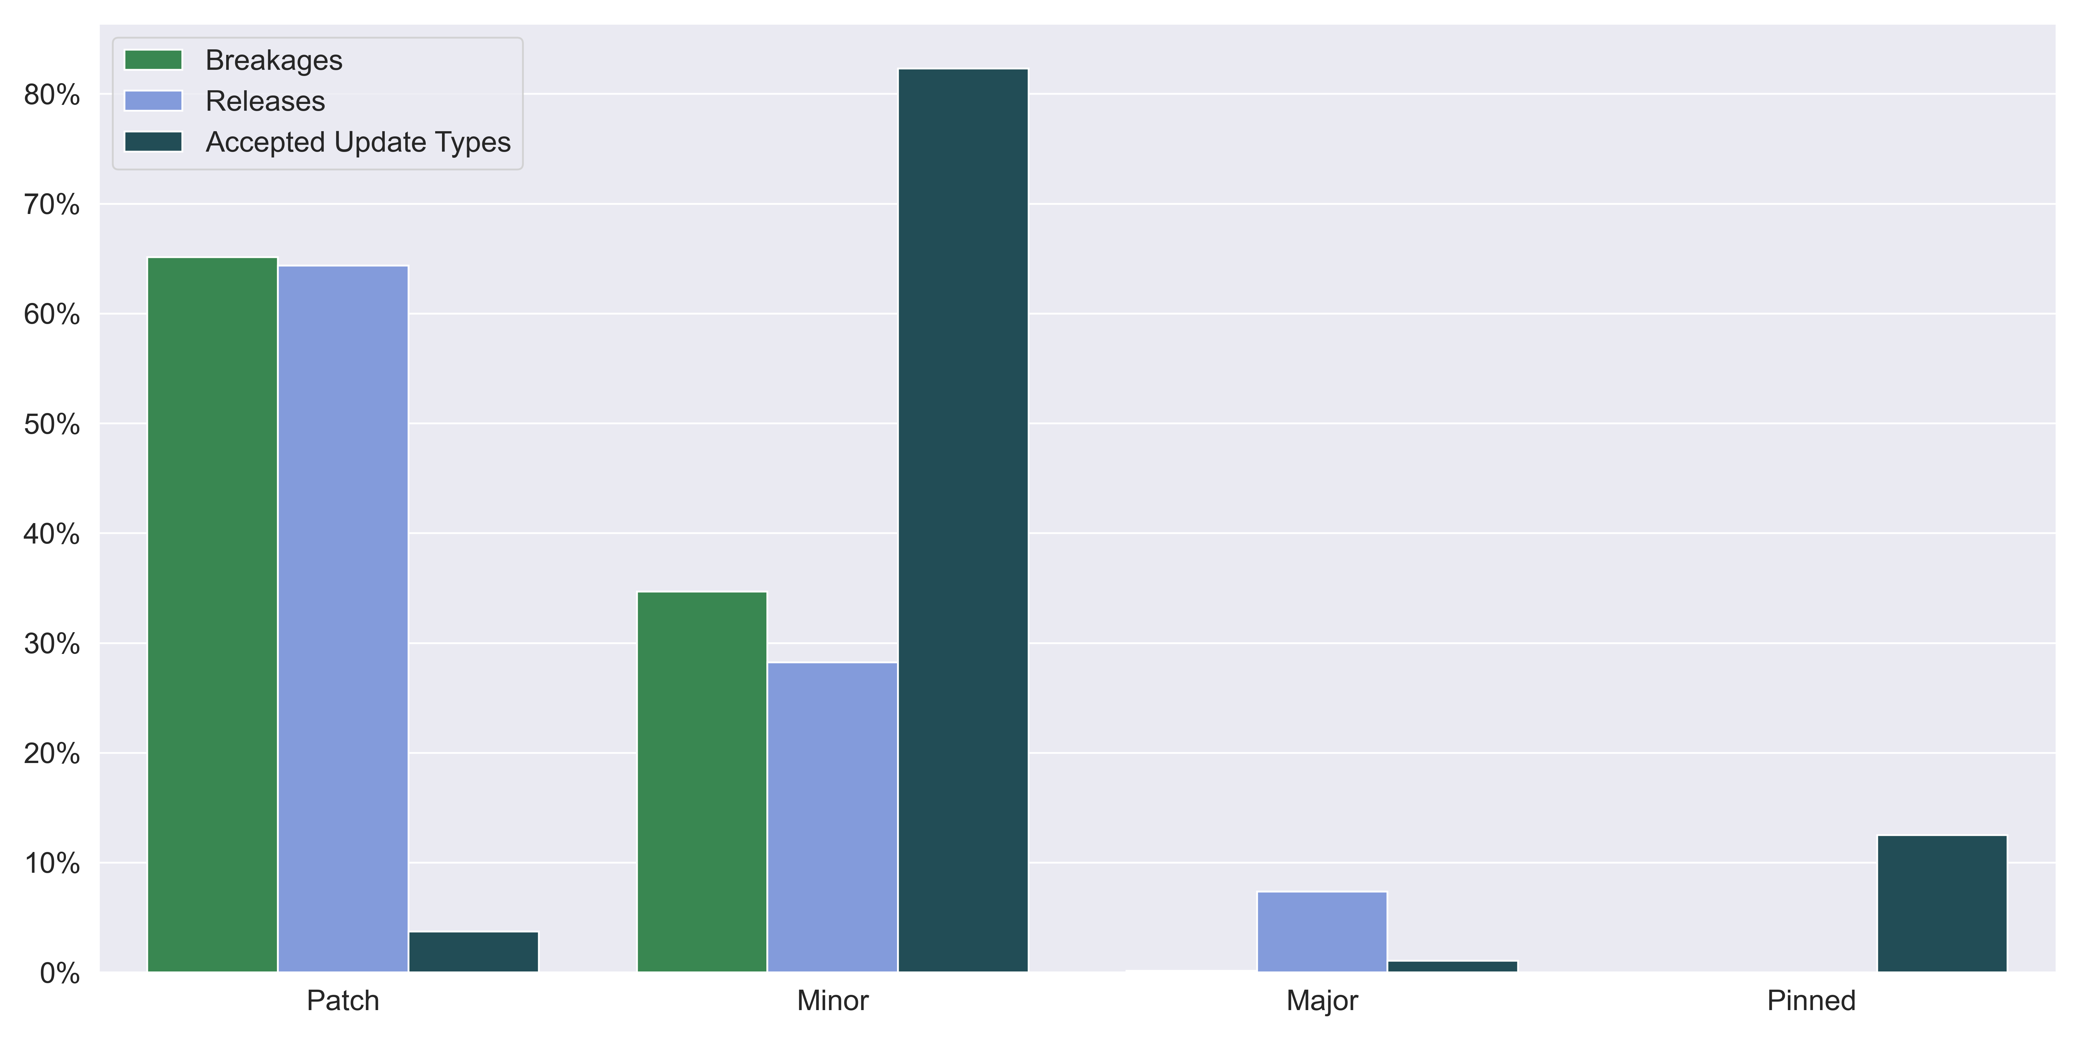
While the majority of clients will accept minor updates, most breakages are caused by patch updates
Notes:
For RQ1, we first wanted to see how the in-range breaking updates were distributed across different update types. Semantic versioning splits updates into three categories: Patch, Minor, and Major.
Most of the activity here is happening on the Patch and Minor updates. You can see that the proportion of breaking updates is roughly equal to the proportion of releases for both of those types. You’ll notice clients have specified they would like to receive minor updates for over 80% of their dependencies and under 4% for patch updates, but this is because when you specify a version type to accept updates for, you’re also accepting all updates for types below the one you specify. So if you specify you would like to receive minor updates, you will also receive all patch updates.
You can’t really see, but only about .02 percent of in-range breaking updates are major updates. This is because, while major updates still make up about 8% of all releases, very few clients will actively accept them.
You can see on the right that that about 12% of all dependencies are pinned, with no breaking in-range updates or release, which makes sense. You can’t have any breaking updates if you don’t accept any updates.

Slide 6
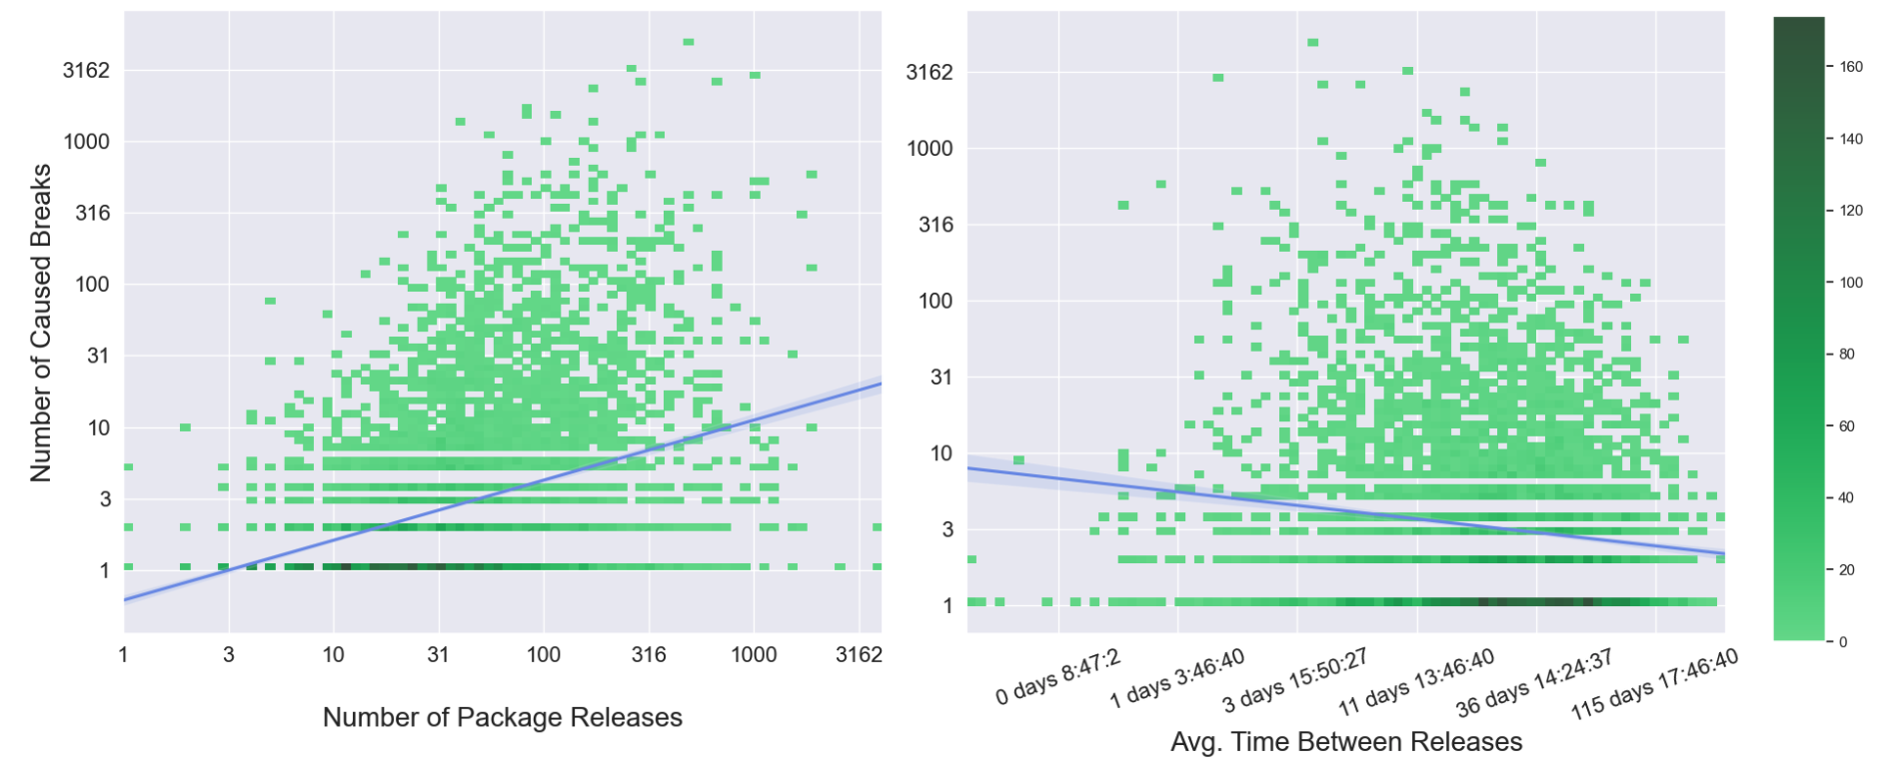
Packages with higher total and more frequent releases tend to cause more breakages
Notes:
Another factor we wanted to investigate was whether the release frequency of provider packages tends to have any affect on how often they release updates that break their clients. The graph on the left shows the distribution of the total number of releases each package has against the number of in-range breaking build updates it was the cause of. You can see that the trend line tends to increase, but intuitively that’s kind of expected. The more releases you have, the more chances there are of you breaking someone’s build.
The graph on the right shows the distribution of build breakages caused by a provider against the frequency at which they release new versions. You can see there is a weak trend for the number of breakages to decrease as the release frequency decreases, but it isn’t strong evidence that one option is safer than the other.

Slide 7
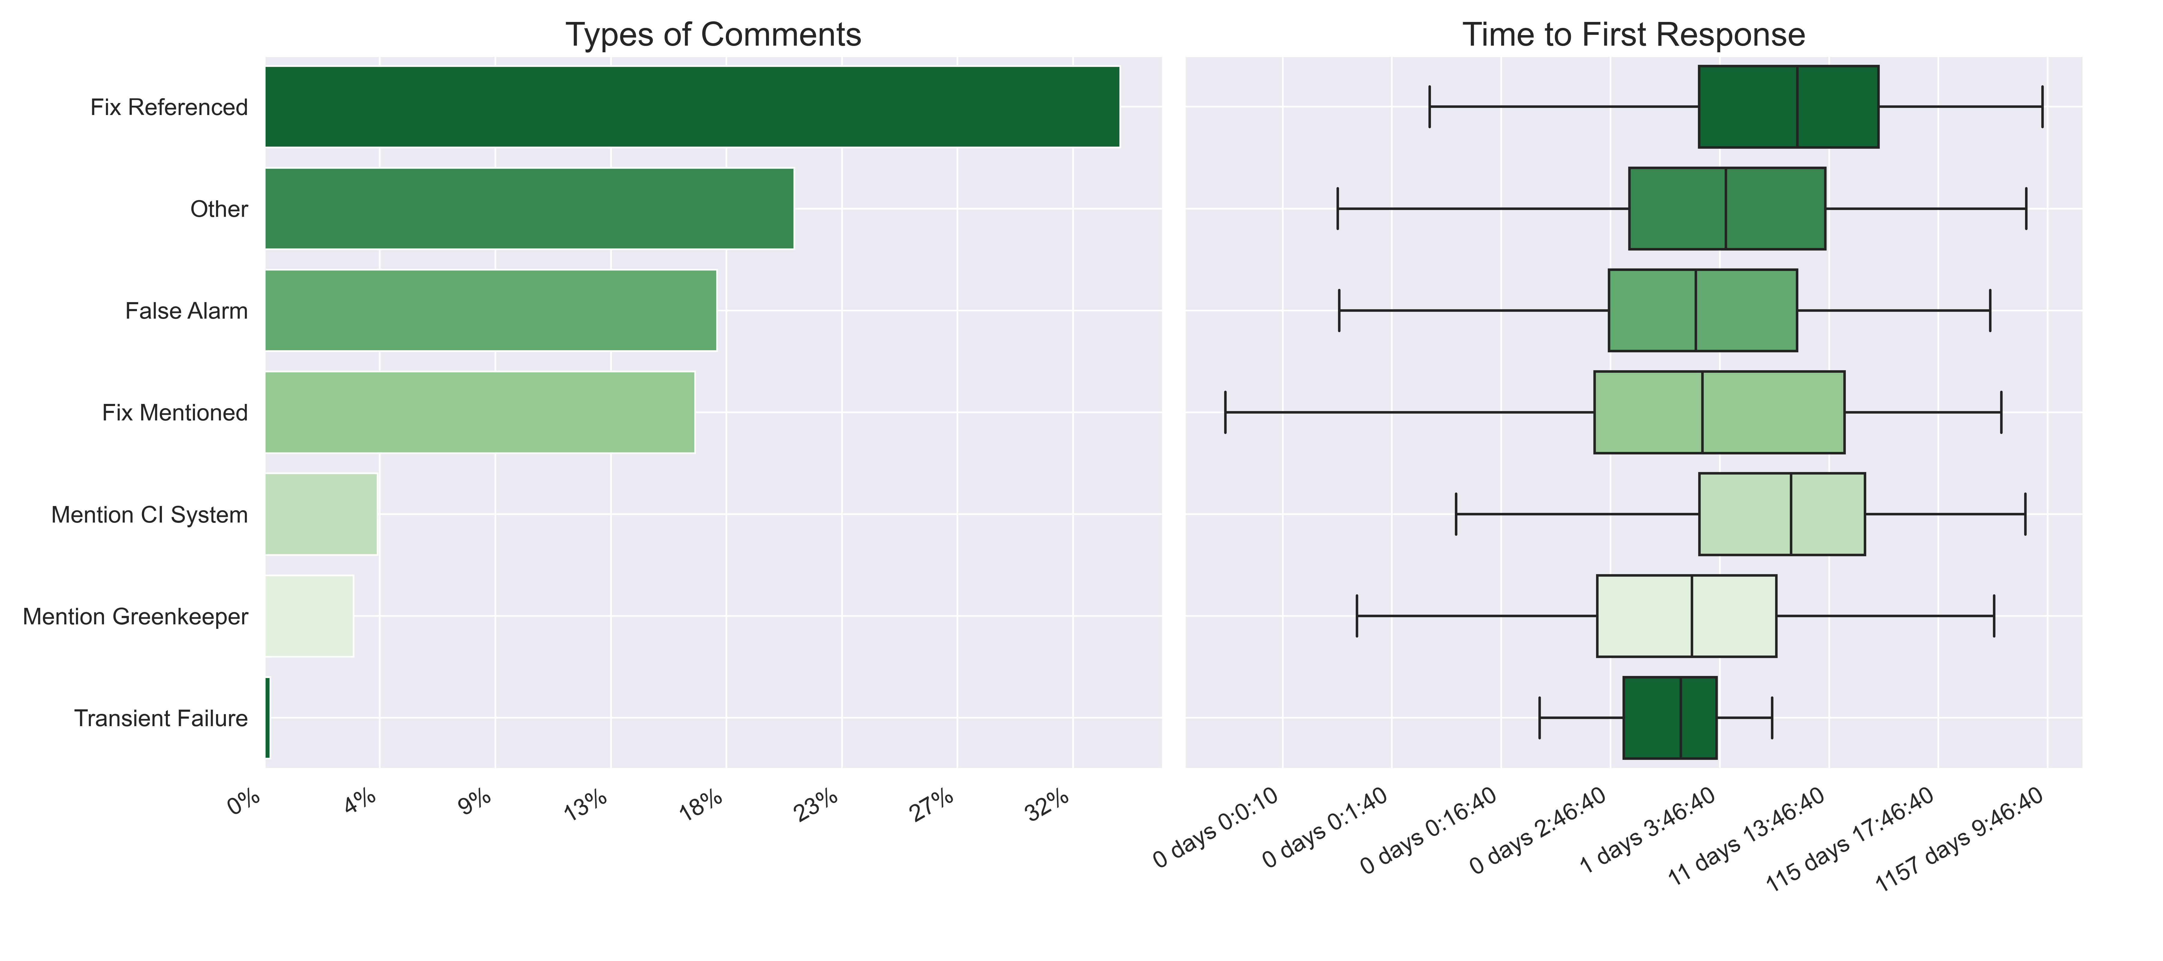
The majority of client responses mention a fix or confirm the issue is invalid
Notes:
So for RQ2, we wanted to see how clients respond to these in-range breaking updates. We classified comments that users were making on the issue reports, and you can see that they are indicating a fix has been made for the issue about 50% of the time. Nearly 20% of the time, the users are indicating that the build failure is a false alarm. So this might have been due to a flaky test or CI hiccup or they mention that they just reran the build and everything is fine. Now again since these are in-range breaking updates, there should be a bit of a sense of urgency when dealing with these issues. You can see that users are usually responding to these issue reports within couple days, including referencing a fix, which I think is a reasonable response time.

Slide 8
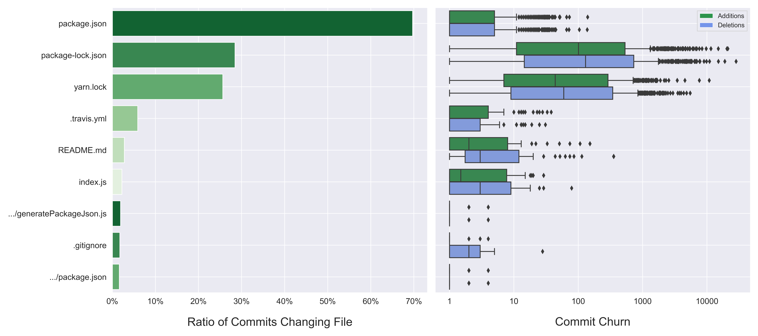
Most fixes involve small changes to dependency specification files
Notes:
So we saw that practitioners are referencing fixes on these issue reports, so we wanted to see what these fixes consist of. You can see that most of the commits that are referenced in the issue reports contain changes to the package, package-lock, or yarn-lock file, which are all files that are used to specify a projects dependencies. Now the two lock files are usually automatically generated and maintained, which is why they have such high commit churn, but you can see that the package.json file tends to have very small changes made to it when these breaking build issues are being addressed. These are typically just modifying the accepted version ranges of packages, so for example, pinning the dependency that is failing the build. This also shows that it is not very common for clients to actually have to modify their source code that uses these dependencies in order to fix their builds.

Slide 9
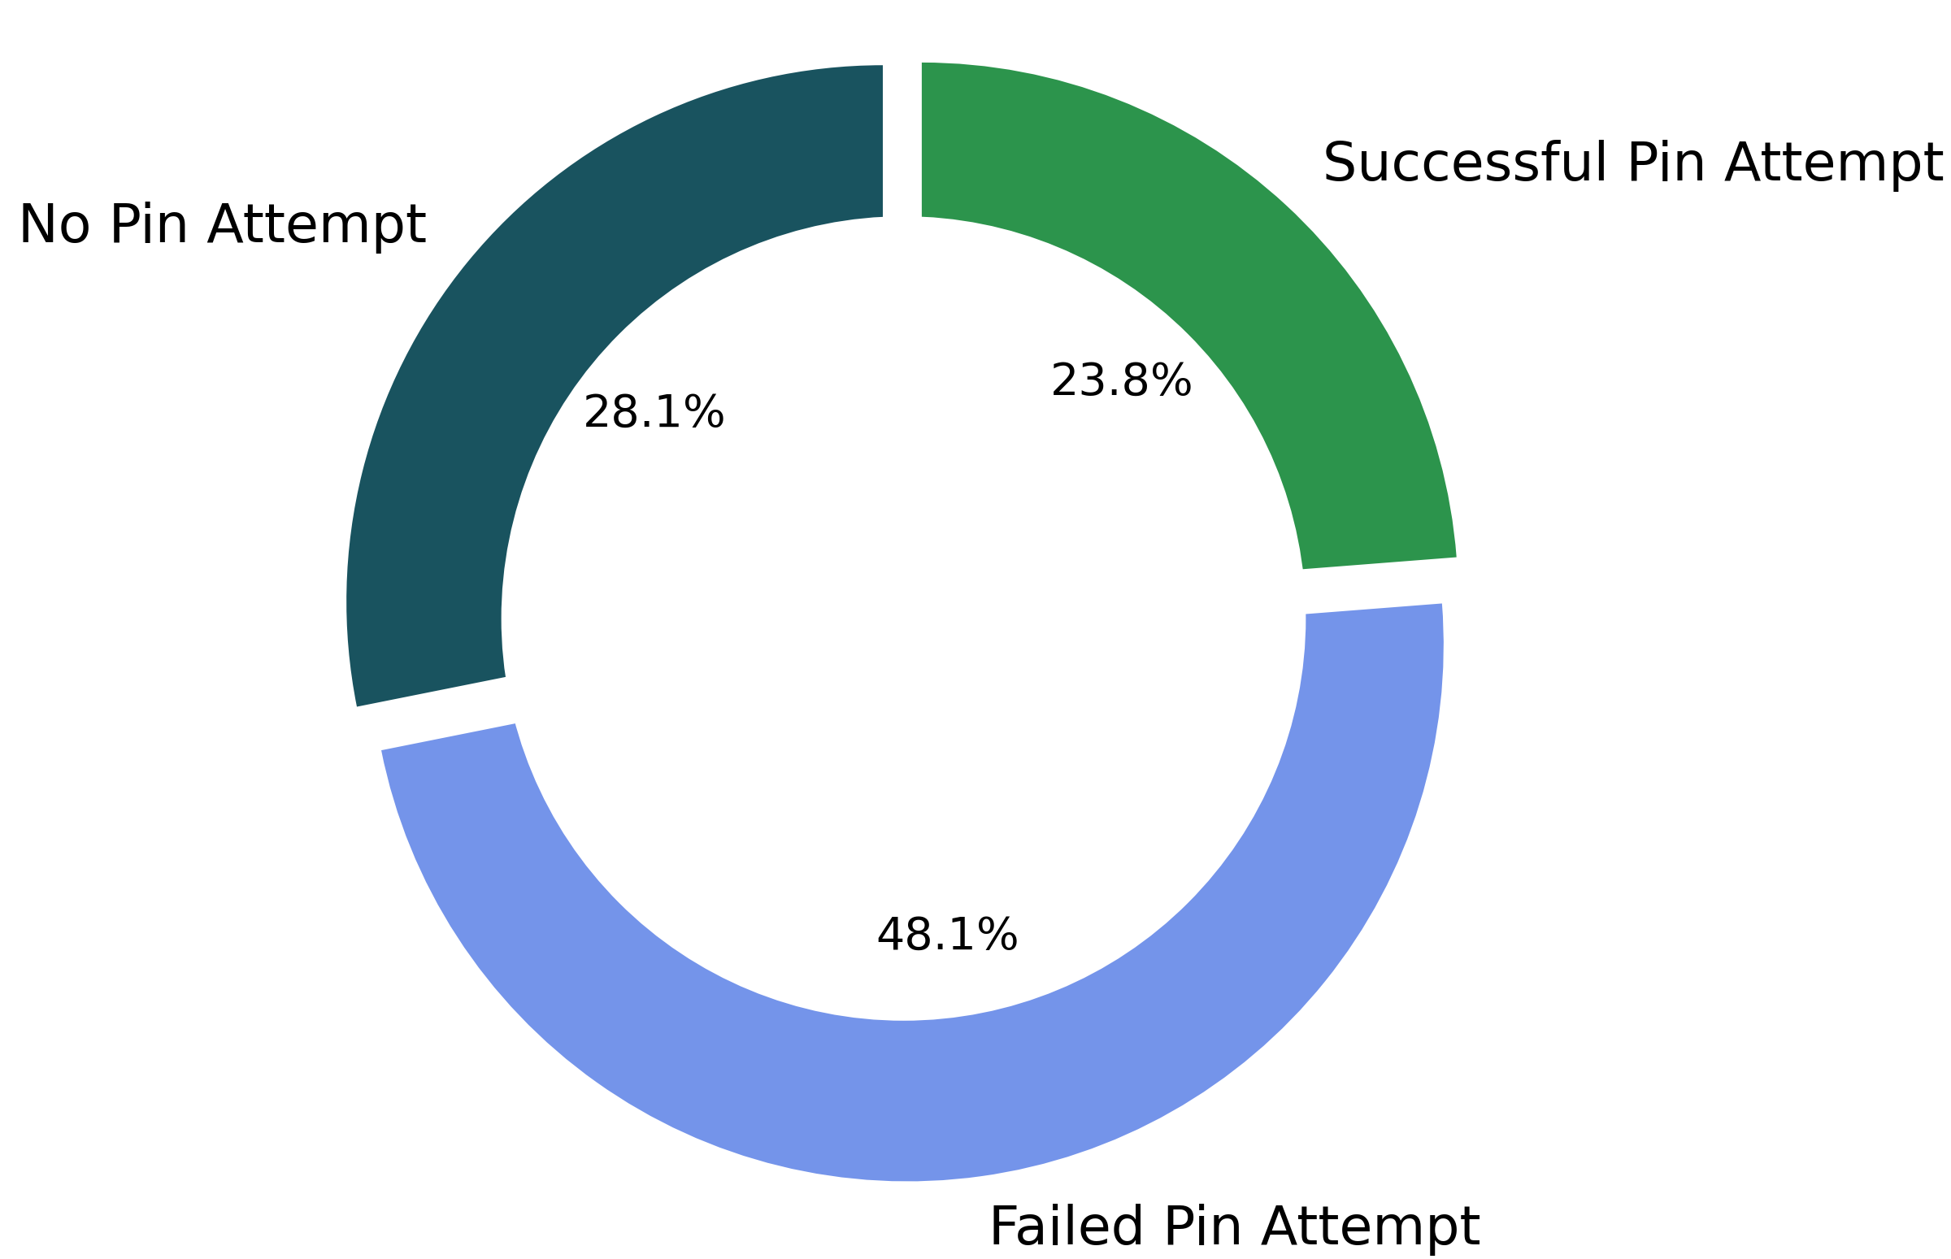
While pinning the dependency is a legitimate option, it is not as successful as expected
Greenkeeper will automatically attempt to pin the failing dependency for most issue reports.
Only about 250 referenced commits were found that matched pinning criteria.
Notes:
One of the first things the Greenkeeper bot will do when it opens a breaking build issue report is try to pin the dependency to the previous version. Pinning a dependency is a legitimate option when developers don’t have the time or resources to fix a problem introduced by a dependency update. Greenkeeper will bundle upgrades for the packages that have to be upgraded together, and it won’t attempt to pin all of the packages in this bundle, which is why 28% of issues don’t have a pin attempt. But for the rest of issues where a pin attempt was made, only about a third of them resulted in a successful build. This actually shows that a good amount of breaking issue reports were not actually caused by the update to the dependency, and raises questions about the amount of noise a bot like this would introduce to a project.

Slide 10
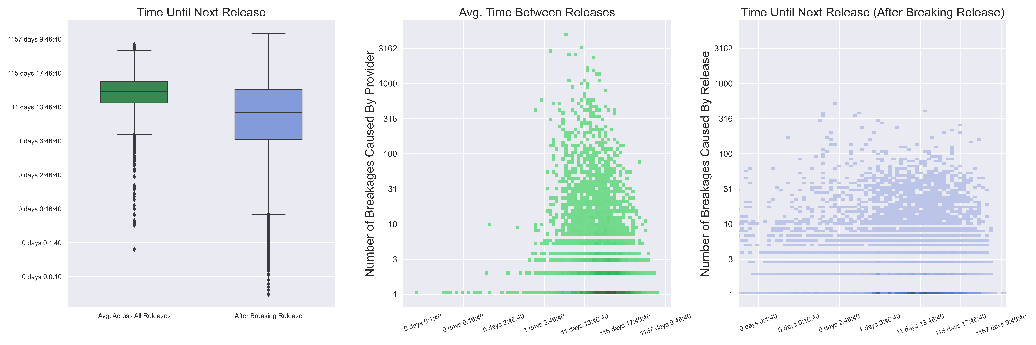
Providers release a new version quicker than usual after releasing a version that break client’s builds
Notes:
For RQ3, we wanted to see if a lot of these failed in-range updates prompt any response in the provider package. We initially tried searching through the comments on the issue reports to see if there were any that mentioned they had opened an issue report with the provider package, but didn’t find any. Now since we had already collected all of the release information for the dependency packages, we decided to look at the release frequency of the provider package immediately after they released a breaking version versus their average release time. You can see on the boxplot on the left that releases that immediately follow breaking releases tend to happen quicker compared to the time between releases across all versions. The other two graphs show the distributions of the release frequency against the number of breakages caused by the package as a whole in the middle, and for a specific version release on the right. So you can see that the right graph tends to have more bins distributed along shorter time periods compared to the distribution across all version releases.

Slide 11
Moving Forward
Manual analysis of pinning failures.
More concrete analysis on how release frequency changes after a breaking update.
Expand study to include issues from Dependabot.
Notes:
There is definitely still work I think that can be done on this project. So you might have noticed that a high proportion of user comments were classified as ‘other’, so I would like to dig into those a bit more to see if there are any other dominant categories I might have missed.
I also want to do some manual analysis on why so many of the pin attempts failed. It’s pretty concerning that the pin failure rate is that high, and I think finding a reason for why so many packages still failed after pinning the dependency would be very beneficial for bot designers.
I think that more concrete analysis is required on how the release frequency changes after a breaking update, so maybe get some hard numbers to put against how much the release time drops after a popular package releases an update that breaks a lot of clients.
Finally, I’ve also been doing a lot of work with Dependabot for another term project, which is another automatic dependency management bot, and I’d like to look into including issue reports from it into my study, to expand the case study. But I think that would be more for moving past term project and into publishable paper territory.

Slide 12
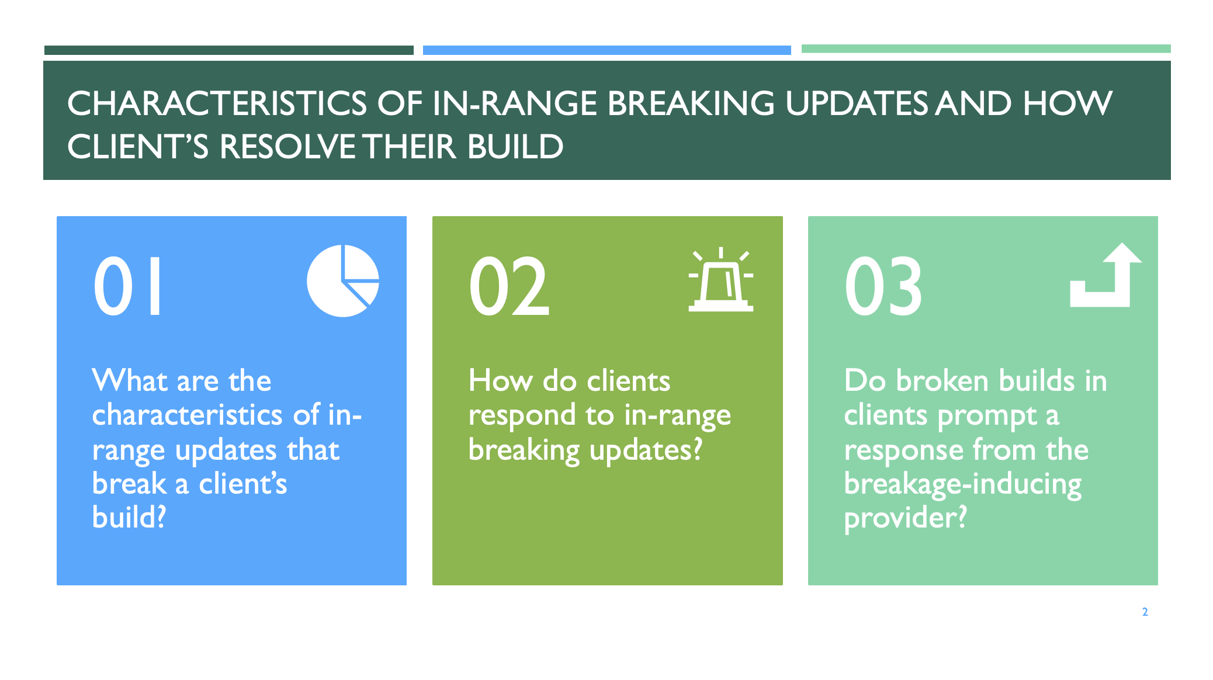
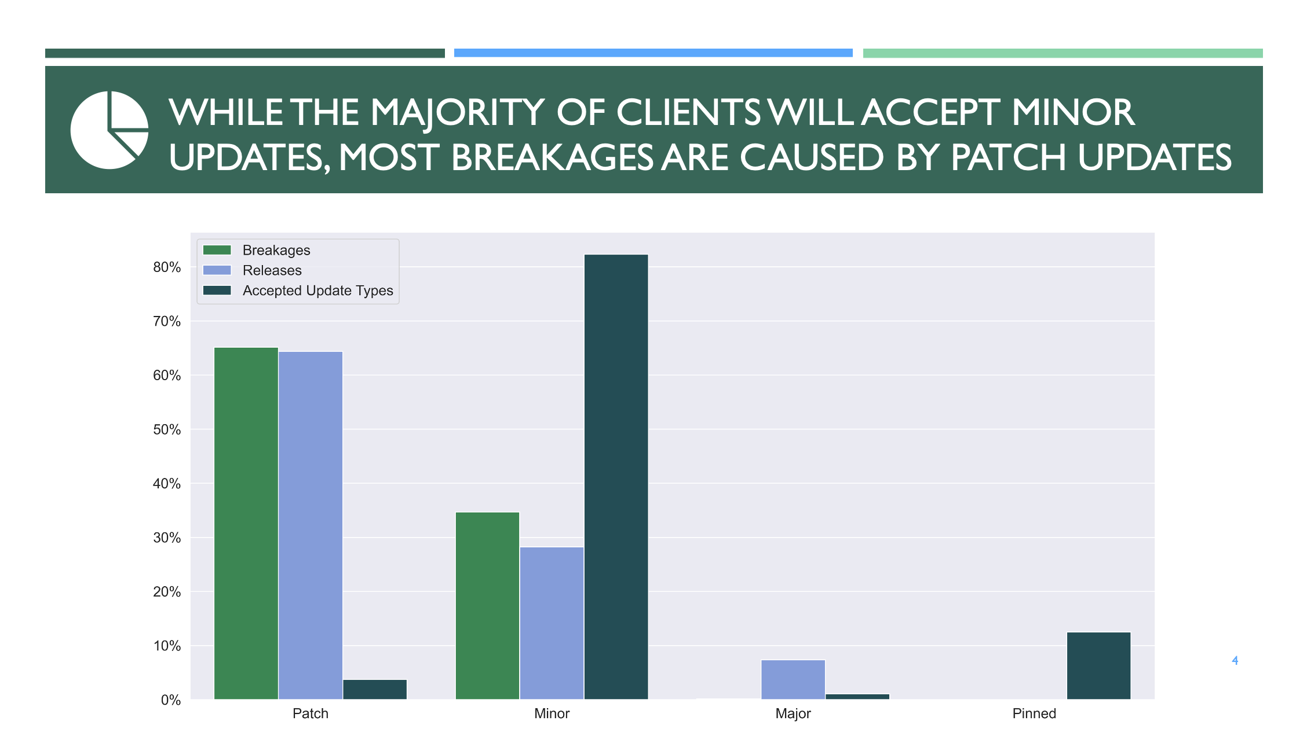
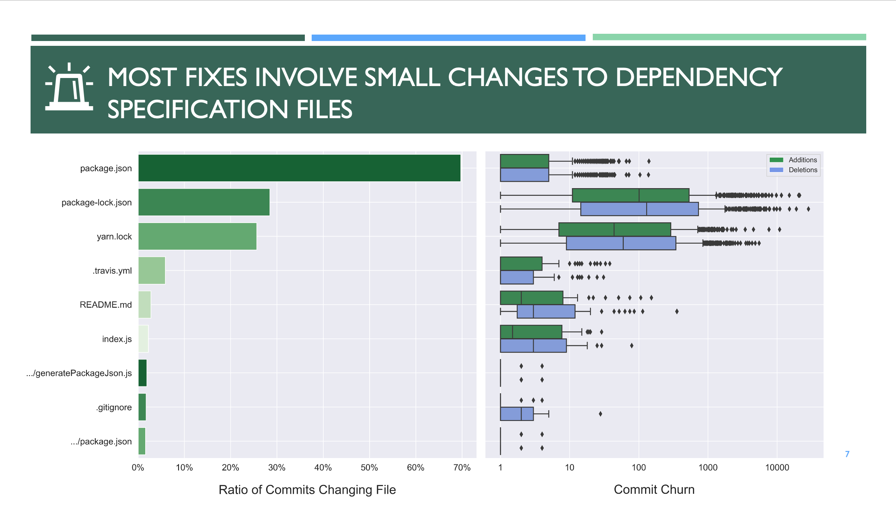
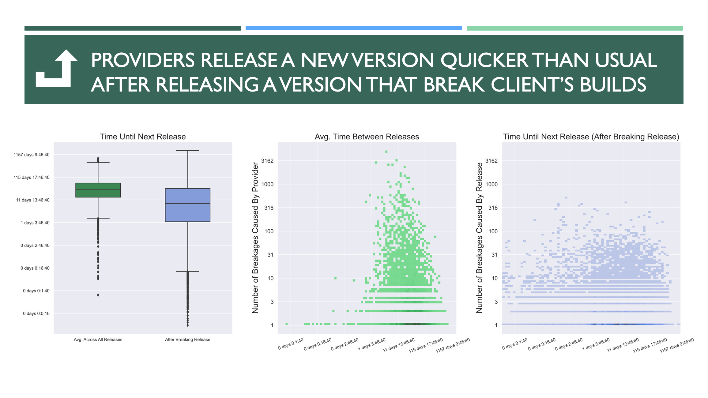
Notes:
So that’s where we are right now. Any questions, comments, recommendations?

